Slide 1
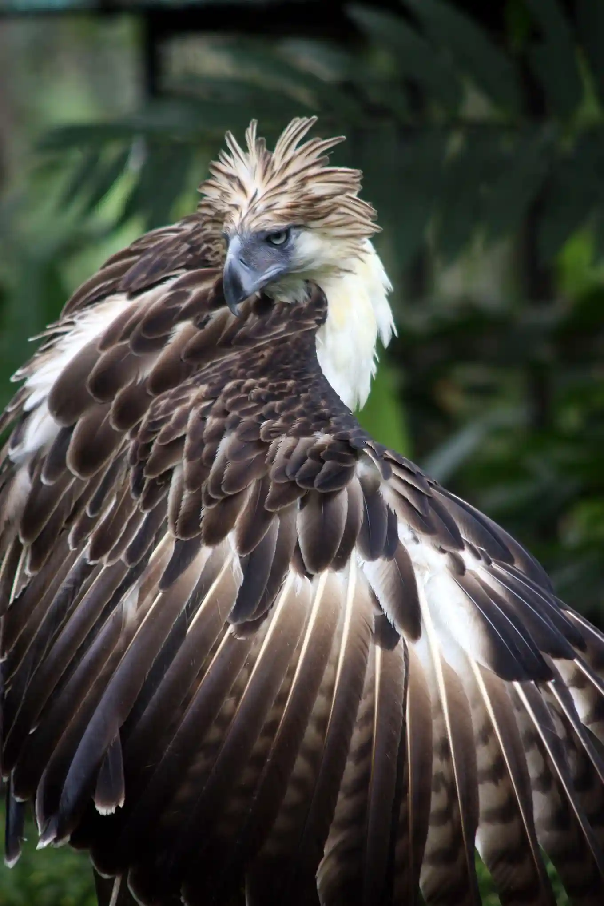
Wildlife conservation & management
Deon Roos

Slide 2
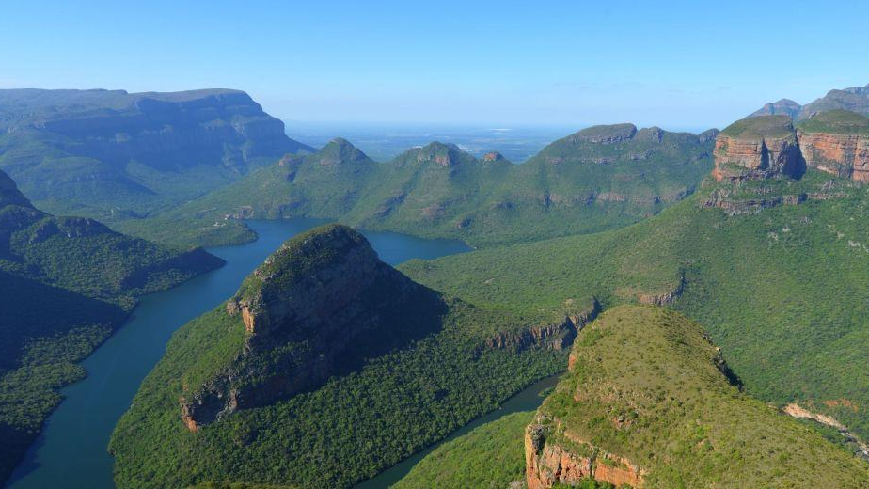
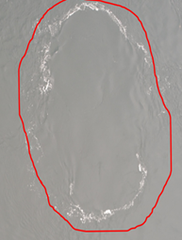
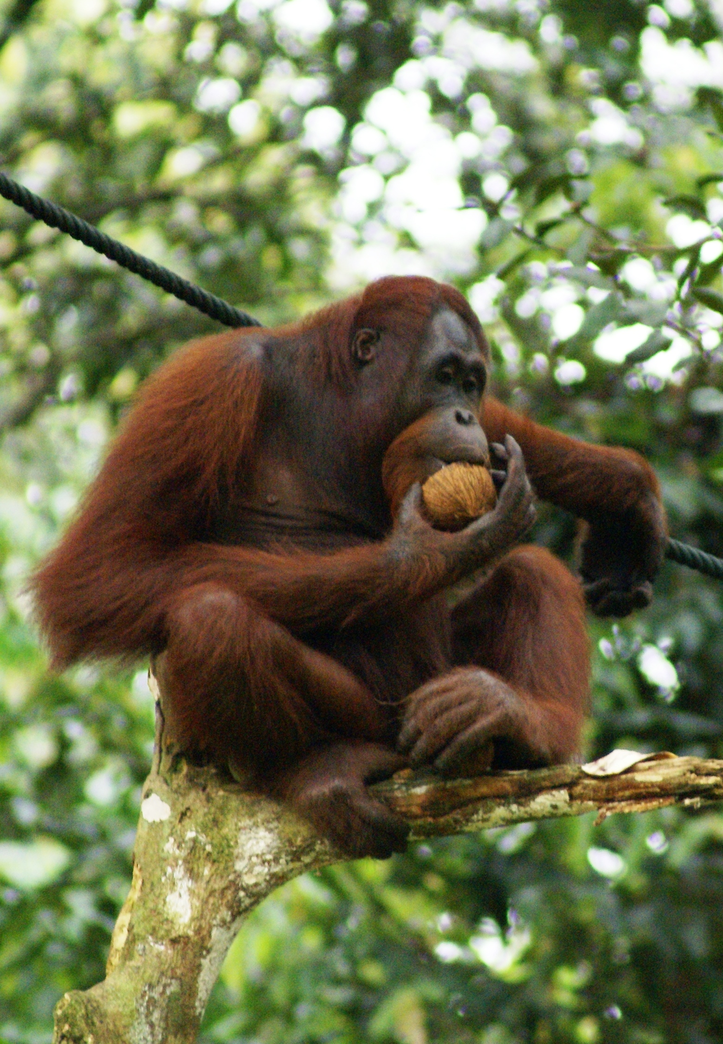
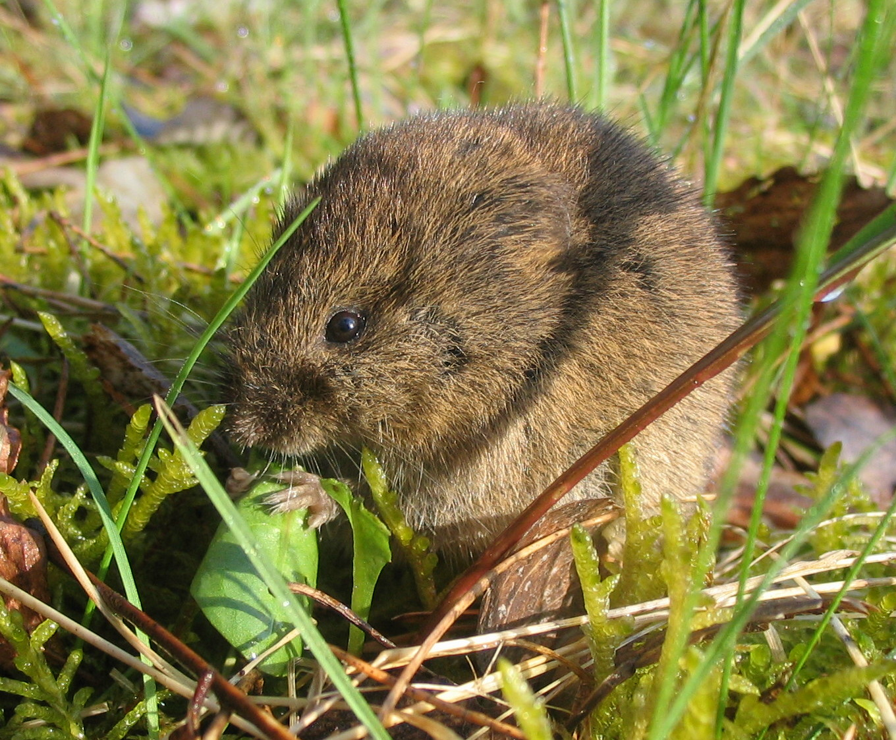
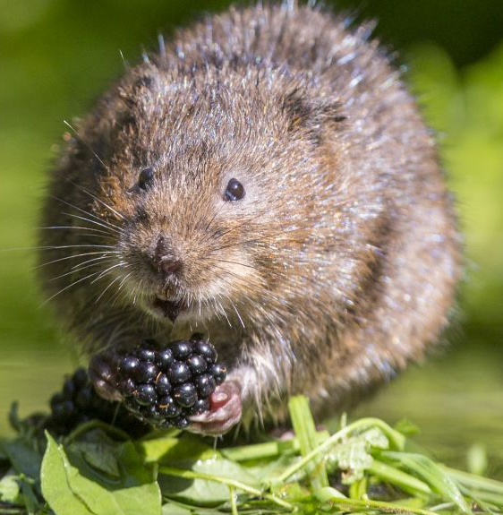
Housekeeping:
This course aims to replicate “real life”
Both the data and the tasks
2-4 hour long methods lectures
Broken down into 20-40 minute mini-lectures
Case study lectures – real life use of methods
Practicals will be virtual
Feel free to critique or offer alternatives

Slide 3
Aims of this course
Understand the fundamental quantitative methods
Teach you four core quantitative methods to help you do conservation and management.
Get some practical experience using methods
So you can put on your CV “I know how to do X”
Have you appreciate the statistical concepts
So you can put on your CV “I know why to do X”
Use results to guide decision making
Get experience using results to help guide decision making in a conservation setting.
Have you appreciate how statistics relates to biology and wider world
Why do we bother with stats in the first place
Have you be critical of science
Do not trust something just because it is published

Slide 4
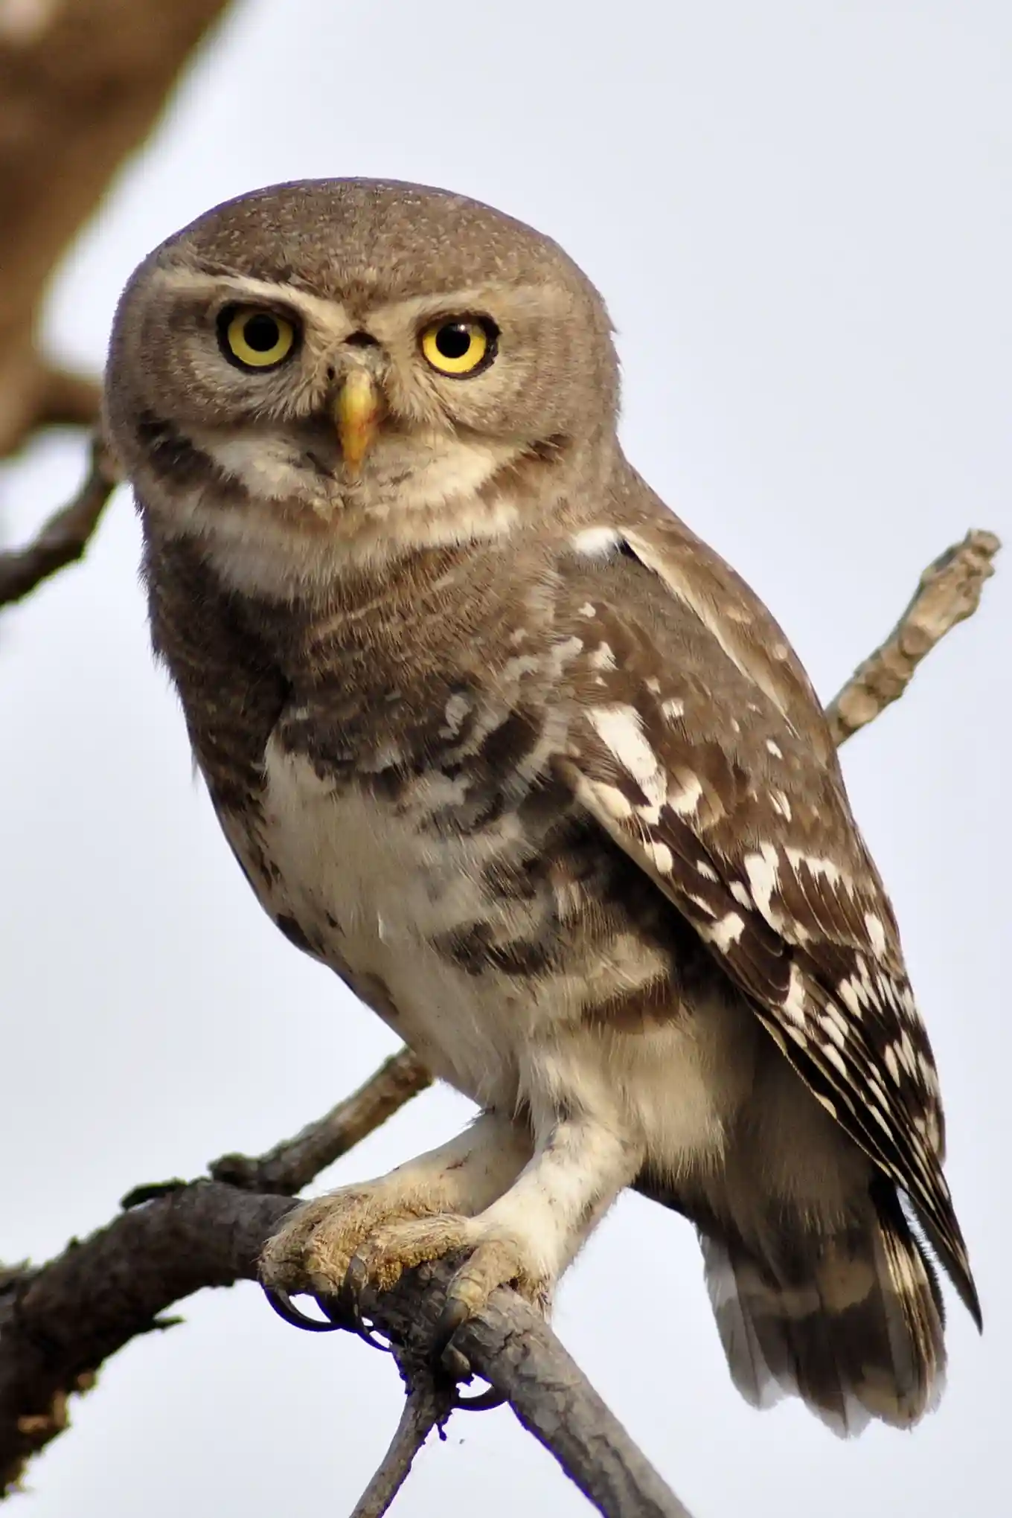
What is conservation?
Can be crudely boiled down to a generic problem and solution.
Problem: Too few animals (or will be soon)
Solution: Have more animals

Slide 5
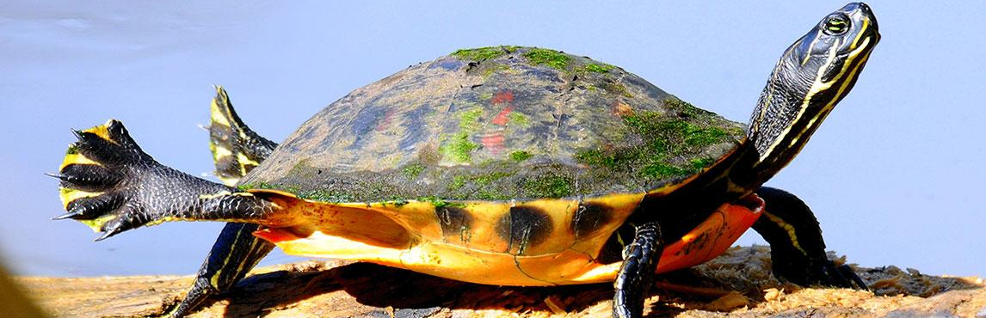
What is species management
Problem: Too many animals (or will be soon)
Solution: Have fewer animals

Slide 6

Different faces of the same coin
The problems faced by both conservation and management are exactly the same. The key difference is that the directions are reversed: too few in conservation; too many in management.
Figuring out what to do for both follows the same steps and must be based on the ecology/biology of the given species.

Slide 7
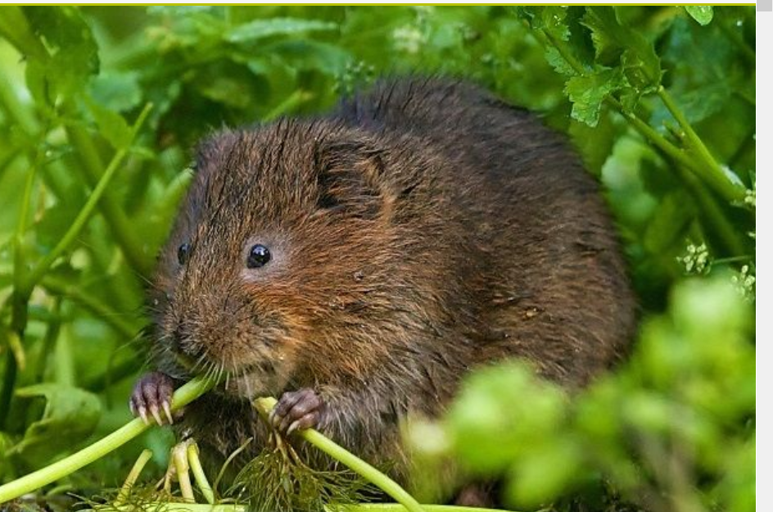
Different faces of the same coin
Same species, completely different scenarios:
Problem: Too few water voles (UK)
Solution: Eradicate mink (increase survival)
Problem: Too many water voles (France)
Solution: Pesticide (decrease survival)

Slide 8
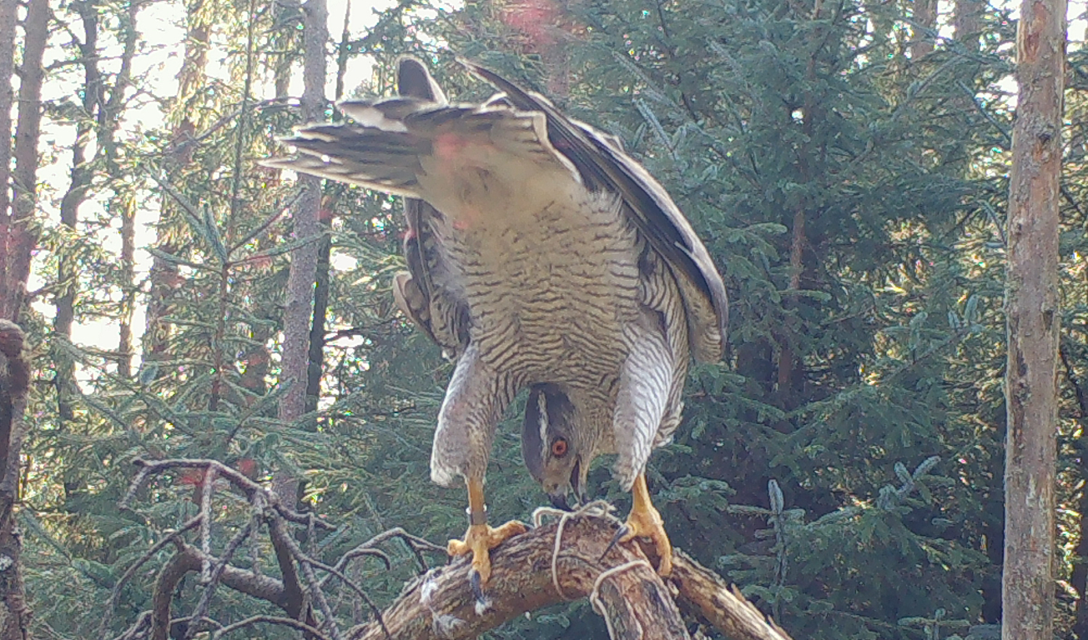
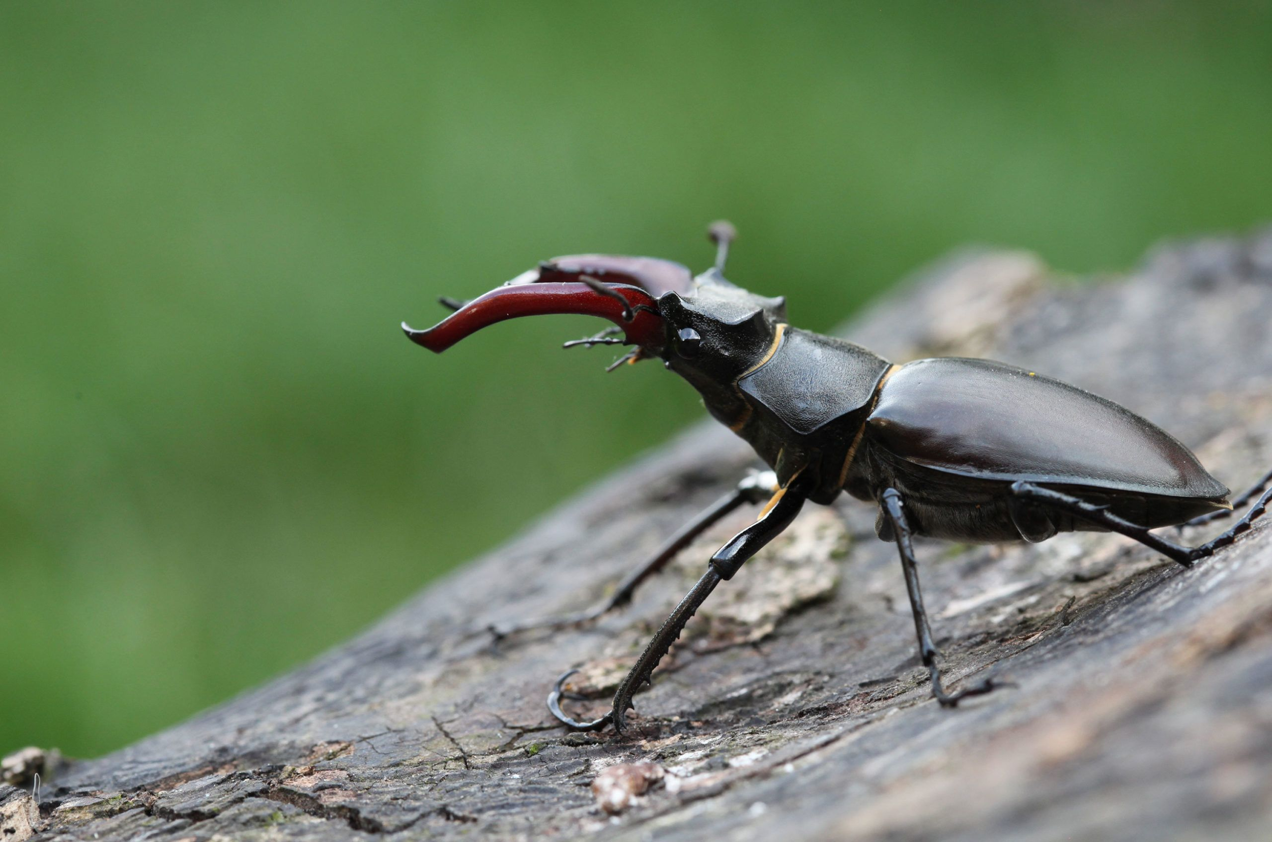
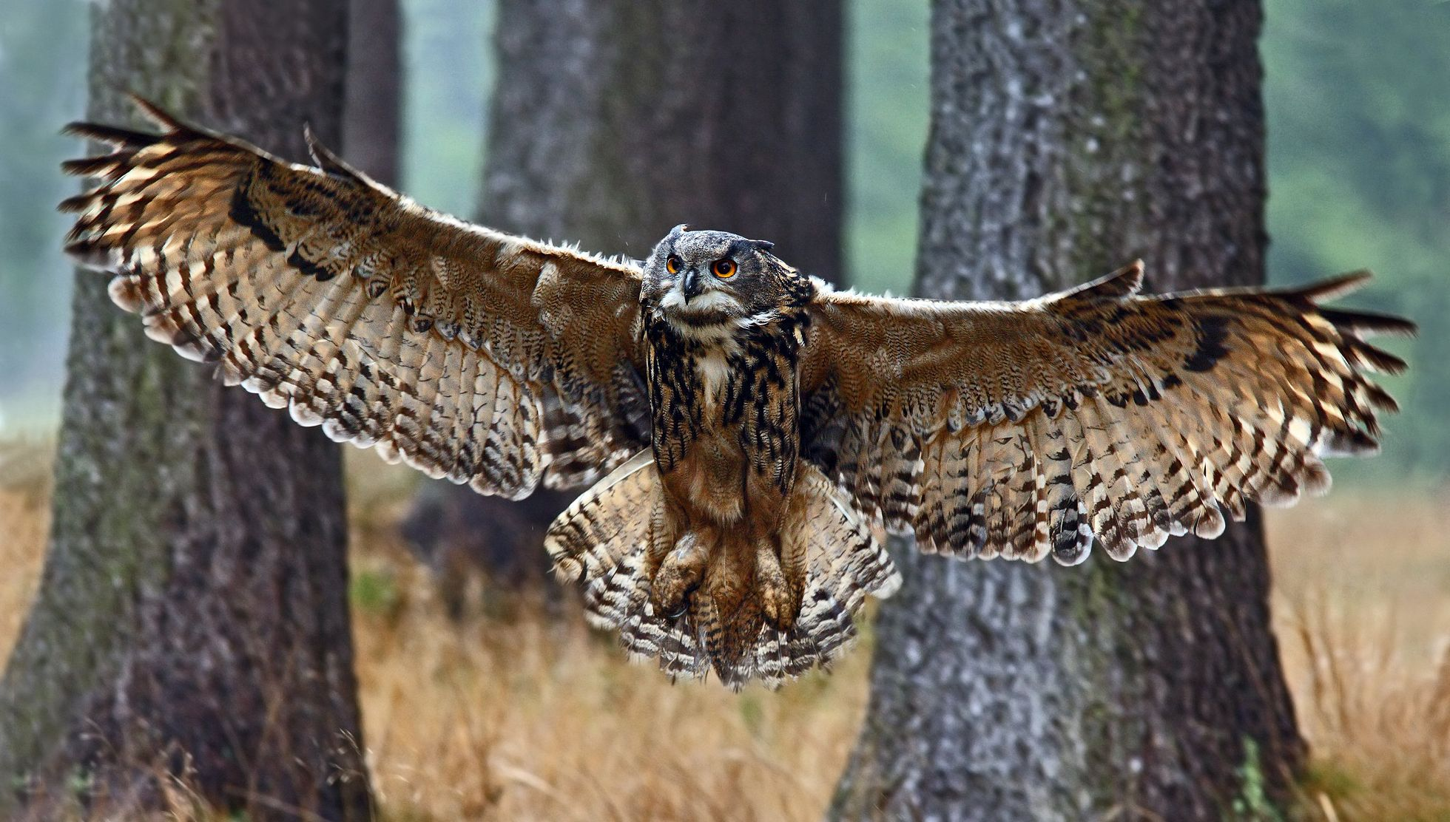
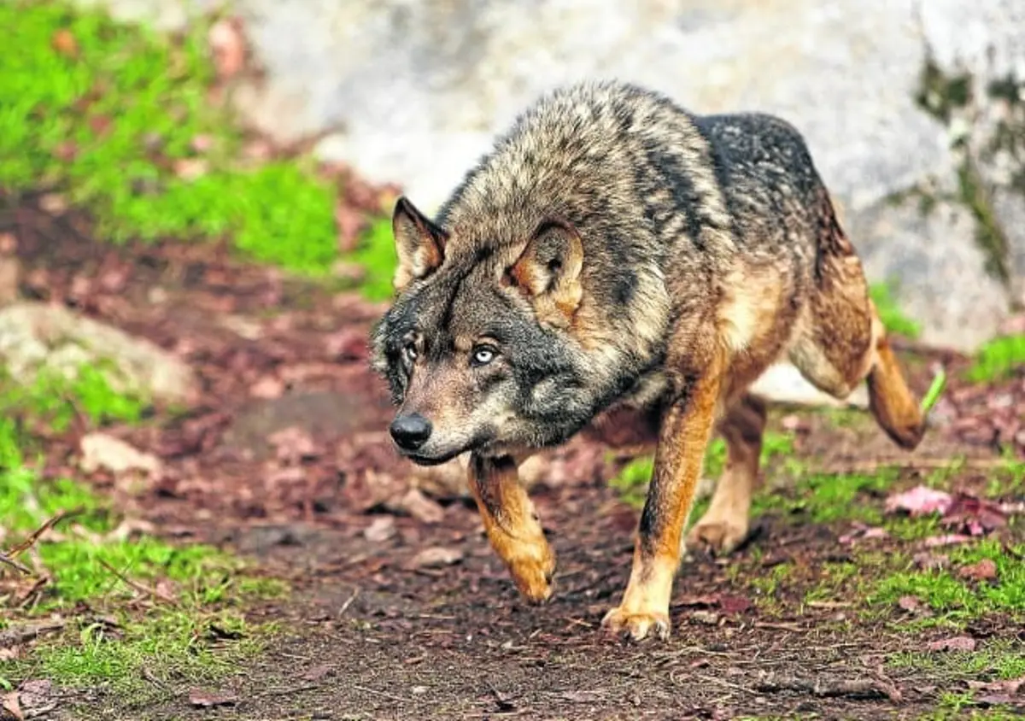
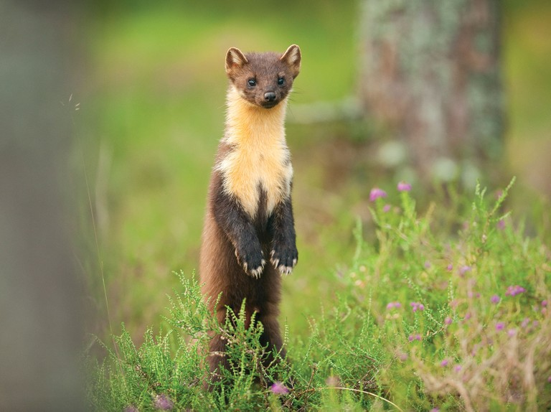
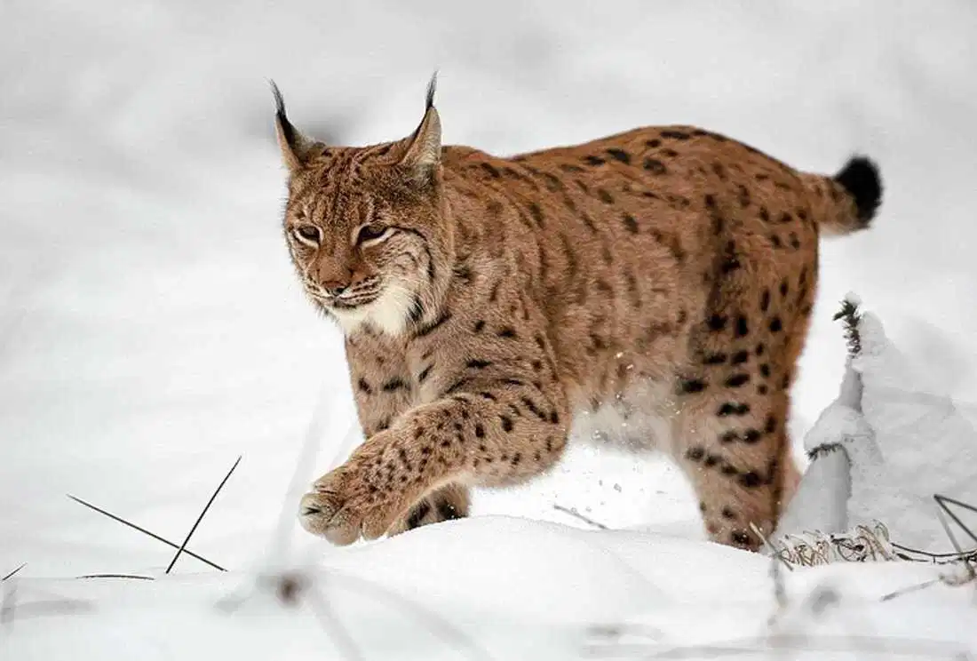
Native species are recovering

Slide 9
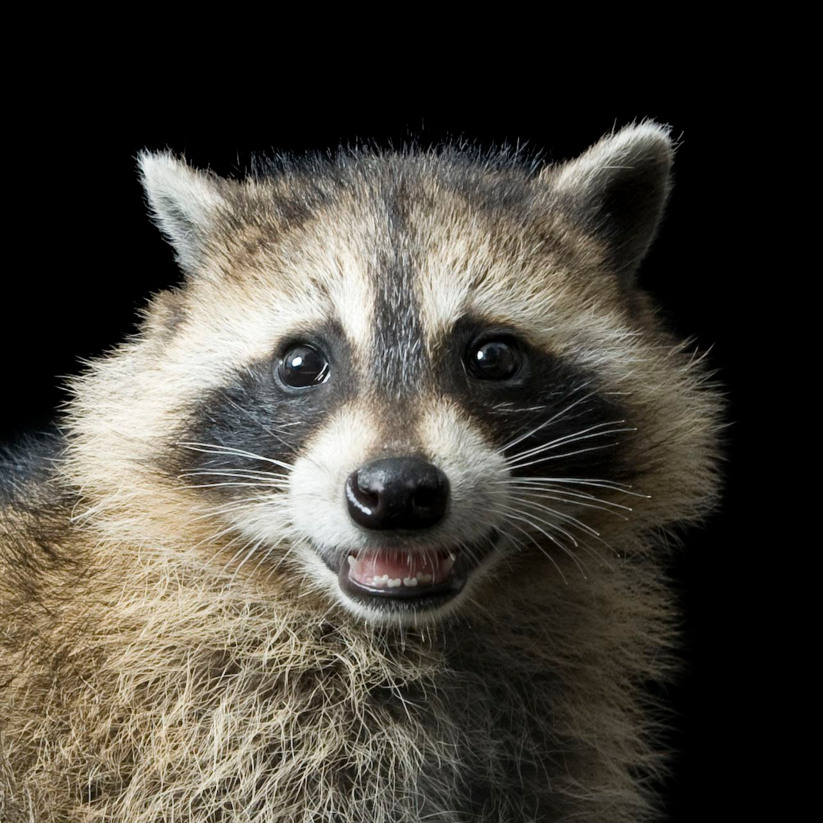
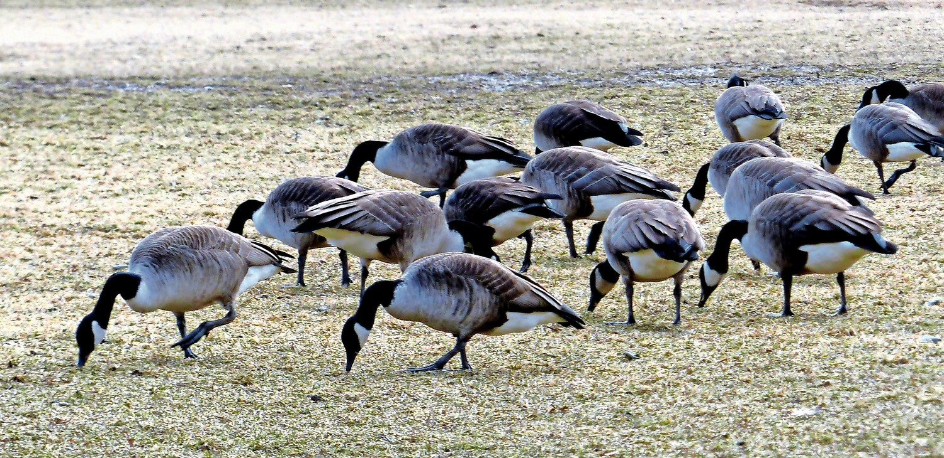
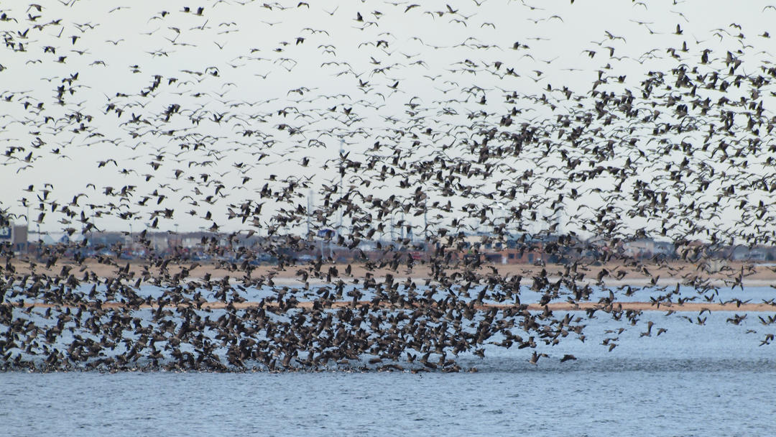
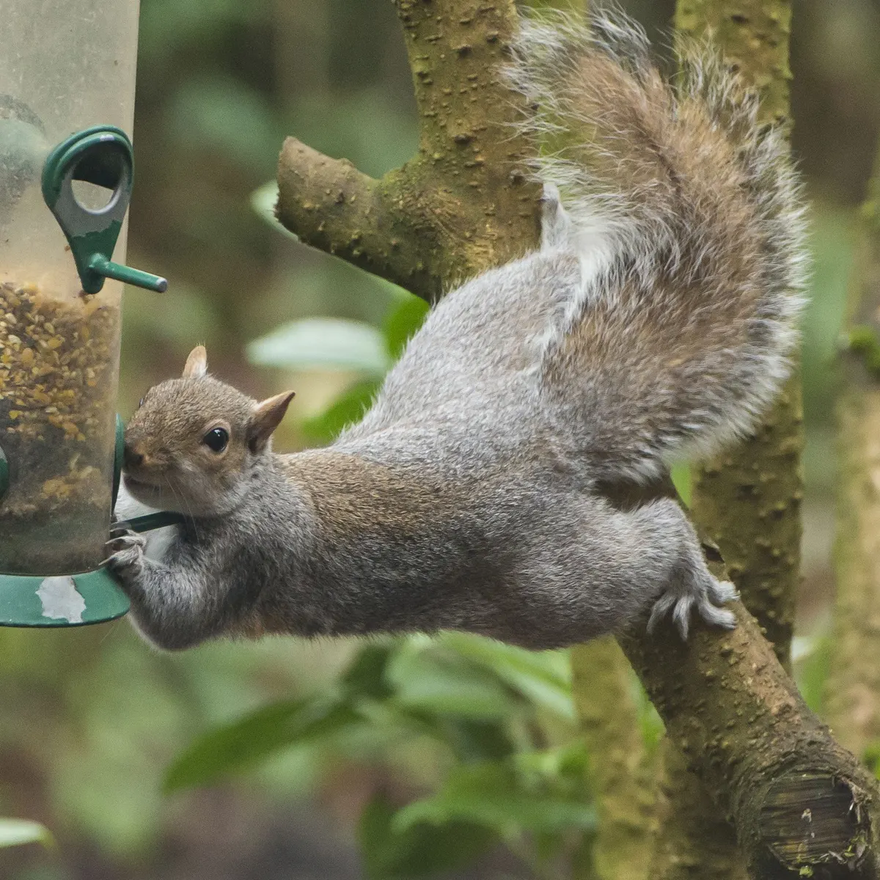
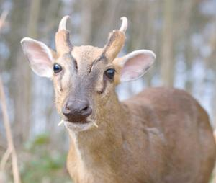
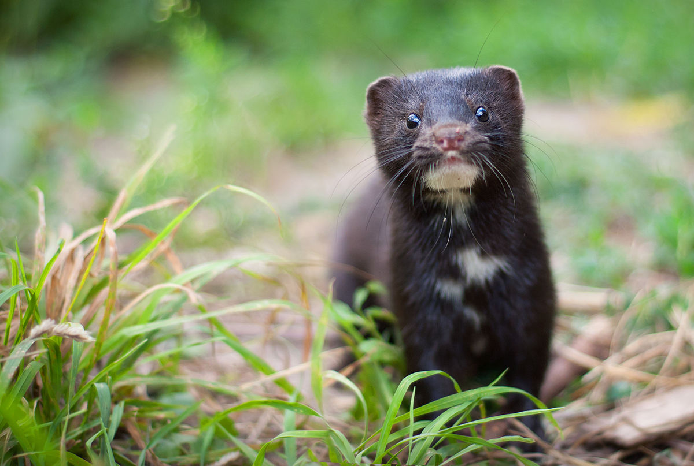
Non-native species are spreading

Slide 10
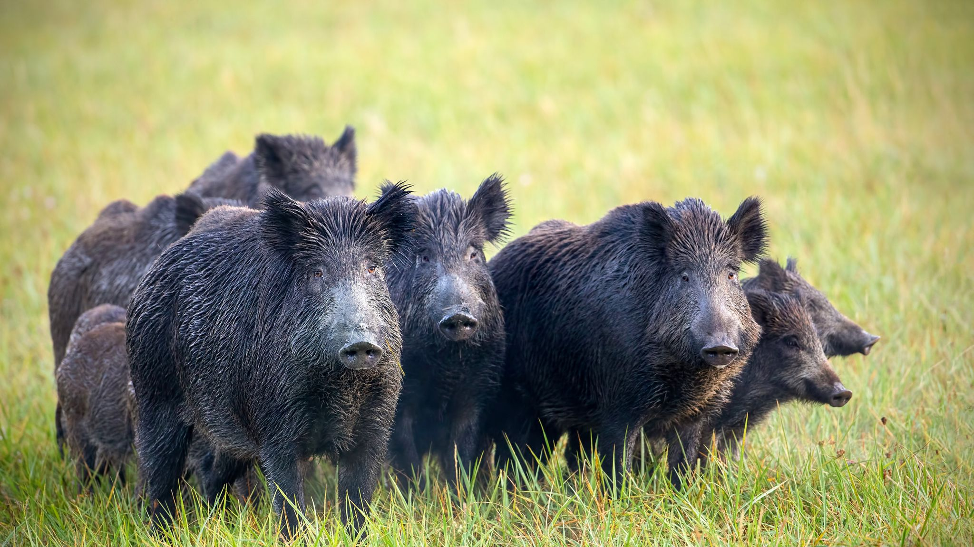
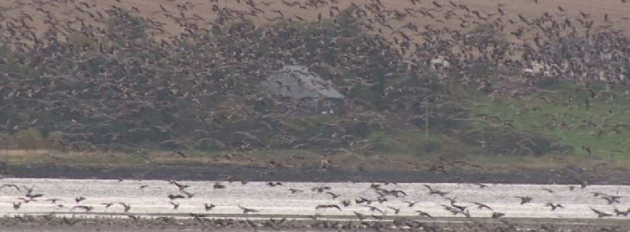
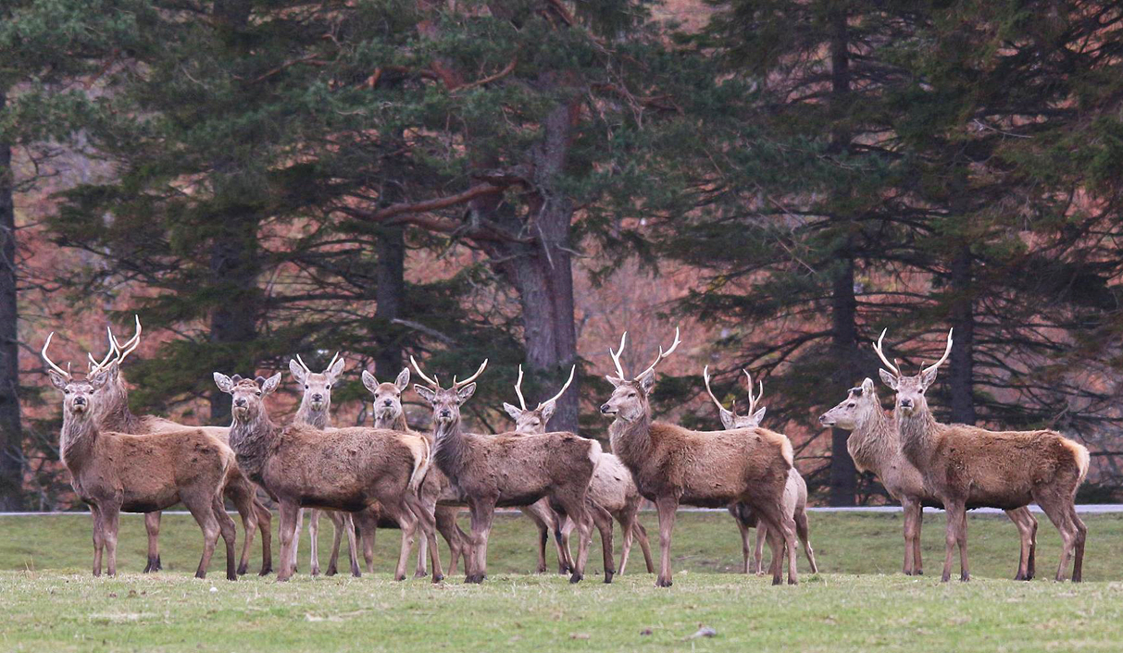
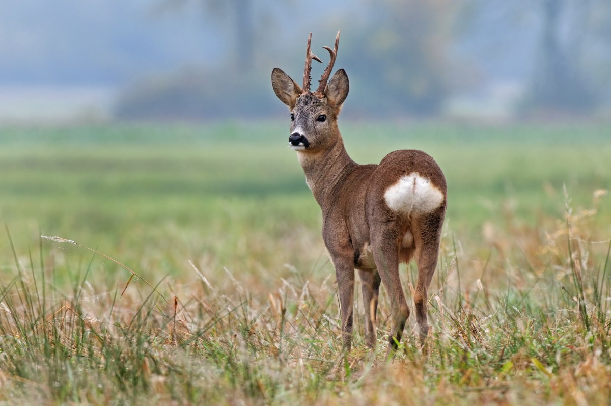
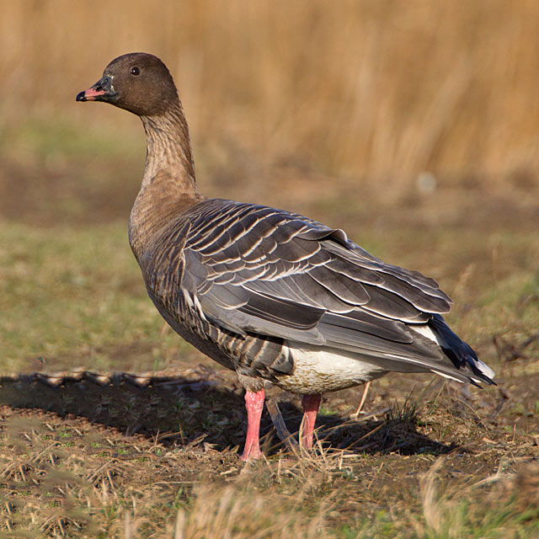
Native herbivores occur at unprecedented densities

Slide 11
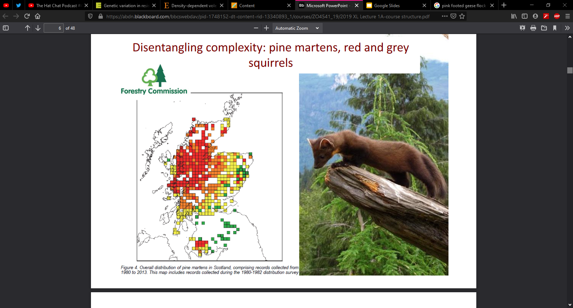
Disentangling complex systems

Slide 12
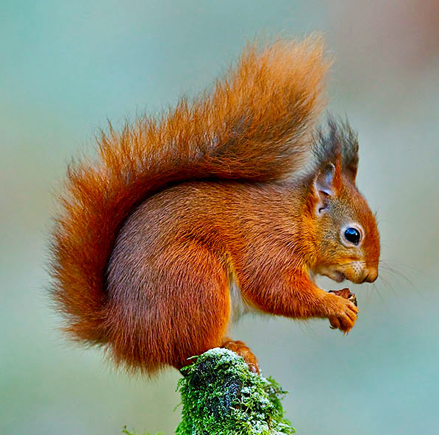
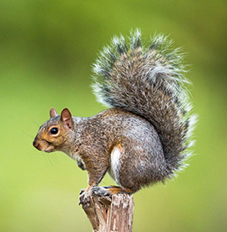
1. Native species decline Grey squirrels have invaded most of UK and pushed red squirrels to near extinction in most places

Slide 13
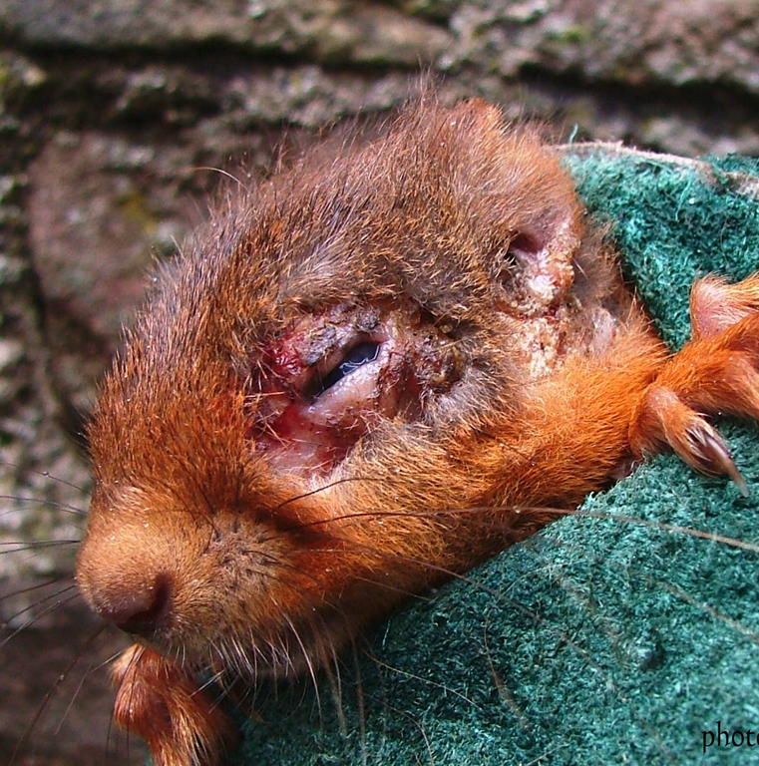
2. Conservation disaster A virus introduced by greys causes acute disease in reds and contributes to their decline. Squirrel pox virus causes disease in reds but not grey.

Slide 14
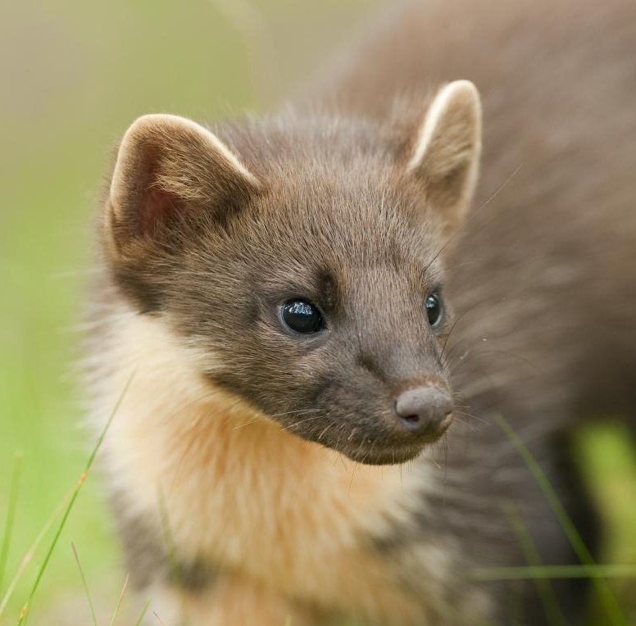
3. Conservation success Pine martens are recolonising their former range. In Ireland, and maybe in Scotland, their recovery is associated with a rapid decline in greys, leaving reds unaffected.

Slide 15
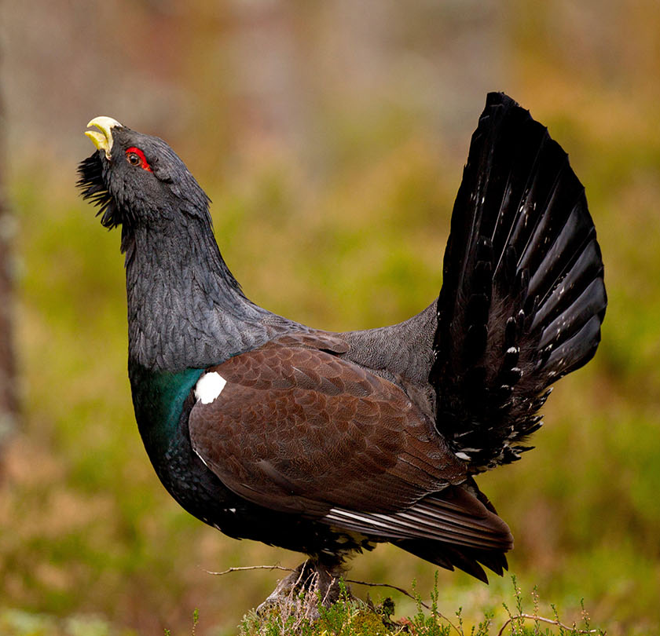
4. Conservation concerns Pine martens predate nests and broods of the endangered capercaillie, causing concerns amongst some conservationists

Slide 16
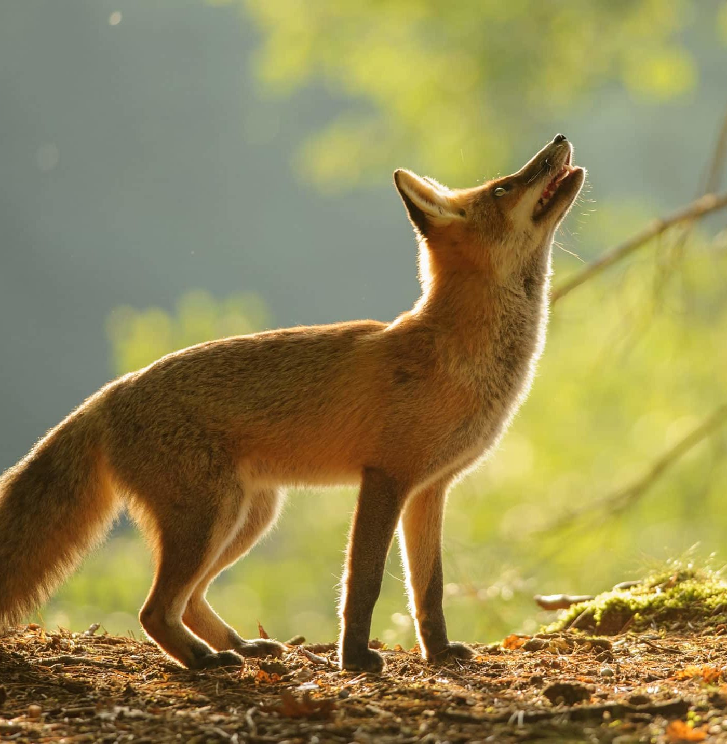
4. Conservation friend or foe? Red foxes predate upon martens, especially in plantation forests lacking natural refugia. They might act to limit the density of pine martens. They also predate upon capercaillie

Slide 17
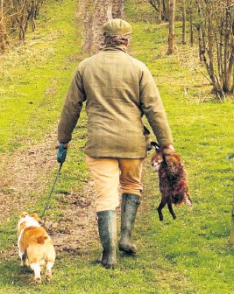
5. Conservation uncertainty Gamekeepers cull red fox. Some also illegally persecute protected pine marten

Slide 18
What do we need to measure to find out?

Slide 19
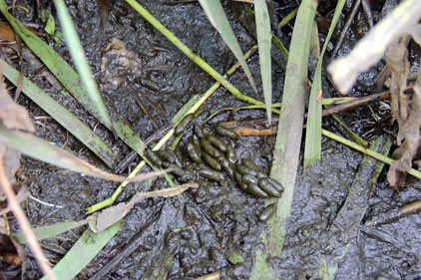
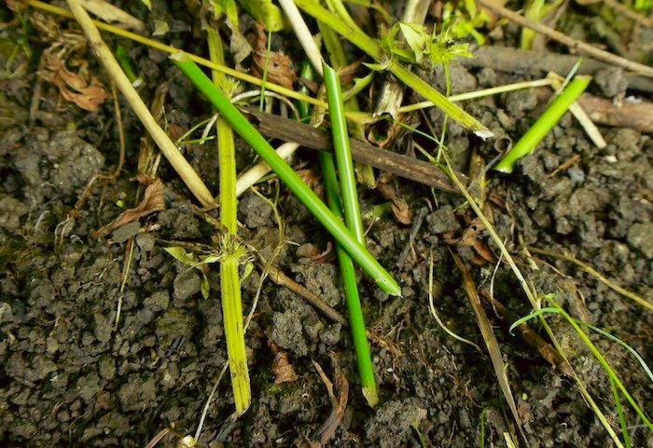
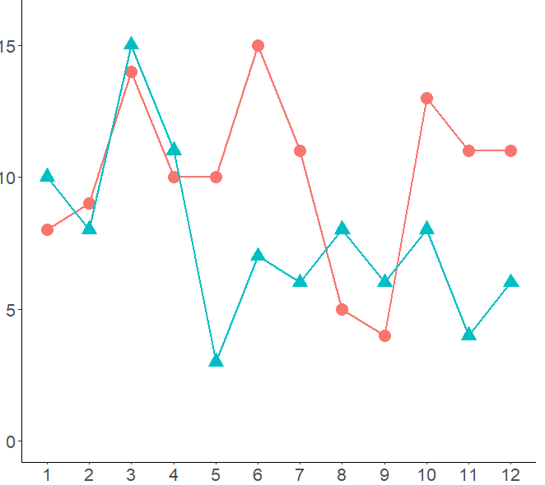
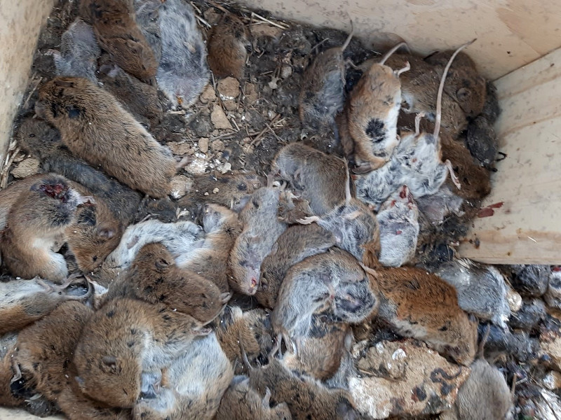
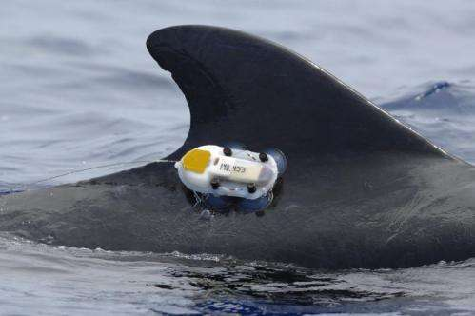
Abundances, rates and dynamics

Slide 20
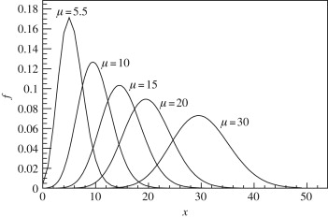
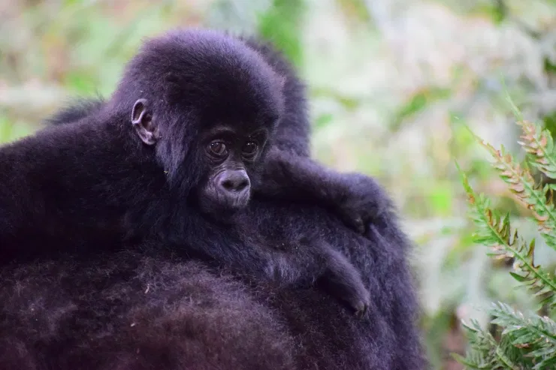
Quantifying problems: Core concept of the course
Decisions must be made with the best available information. The best available information most often comes from the most appropriate statistical analyses.

Slide 21
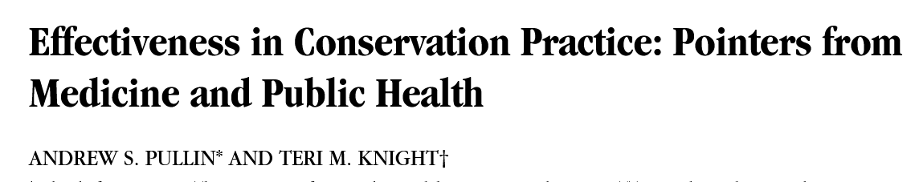
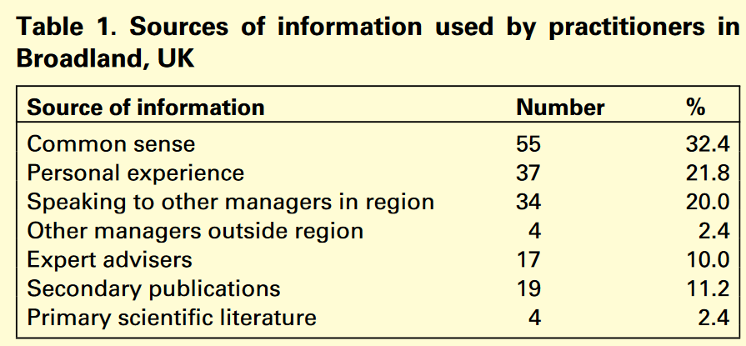
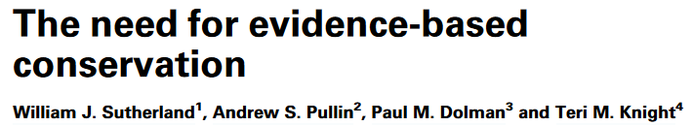
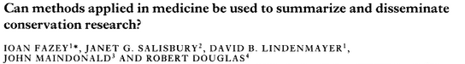
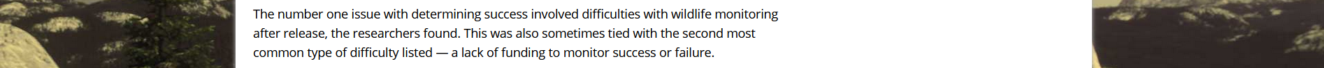
You need to know what’s happening!
This needs to be higher!

Slide 22
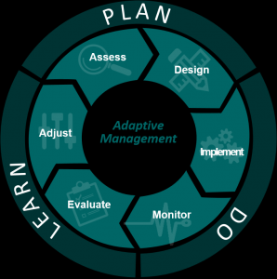
Adaptive management
Is there a problem?
Monitoring & analysis
What’s the problem?
E.g. Survival, reproduction, etc.
What’s causing the problem?
Covariates
What are your options?
Matrix modelling
Are the options acceptable?
Public opinion, logistically feasible?
Has management been effective?
Monitoring
Should anything change?
Adaptive management

Slide 23
Assessments
Advocacy presentations (50%)
10 minute presentations taking an extreme stance on a subject
Done in independent “pairs” where one student says X, the other says Y
Aim is to push you to be critical of science and use it to construct an argument
Models do not show the truth – only an estimate of the truth
Management reports (50%)
3000 word management report outlining your advise to government body
“Based on my analysis of the data, which shows X, Y & Z, I suggest we begin a regionwide cull of dolphins”
Complexity of analysis is not assessed, only the suitability and your advice.

Slide 24
Advocacy presentations
Features of a good presentation
Use a selection of papers to give evidence of your stance
You are free to argue that the existing evidence is flawed
Give meaningful insights into the evidence
(don’t just summarise 50 papers)
Have some key points (ca. 4-5) you want to get across
(don’t just summarise)
Show you understand the field
(no conspiracy theories)
Shows passion for their topic
(make your audience excited to listen to you)
Skilful use of slides
(don’t have walls of text, but also don’t just have pictures)
You will be marked independently of your opponent, but you are encouraged to work together.

Slide 25
Management plans
Use your analysis to come up with a conservation management plan for the Amami rabbit
Every result you gain will be entirely new for the system, so don’t trivialize any result.
Questions to ask:
What are your objectives?
Long and short term.
What analysis did you do?
Quickly summarise for non-specialist audience.
What were your results (for each analysis)?
What are the implications of each result?
Based on your results, what strategy do you recommend to achieve your objective(s)?
You will have to come up with these on your own.
Write the management plan as though the target audience is a family member (or civil servant).
Do not:
Suggest 50 different conservation options in the hopes that one is reasonable (you will be marked down for this). Suggest a handful of carefully considered options.
Do not use bullet points in an official document.
Include irrelevant information
If the diet of the rabbit is not relevant to your management strategy, why tell your reader about it?
If we never covered something in class, do not include it!
You may:
Use an appendix (not included in word count) for any tables. Try not to clutter your document.

Slide 26
Structure of course
Mondays
Methods lectures
Learn about the theory and concepts of the methods
Thursdays
Practical classes
Learn how to implement the methods used for management plan
Fridays (& some Thursday afternoons)
Case study lectures
Real life implementations of species management plans

